Slide 1
Unit-5
Environmental Issues and Pollution Control Acts

Slide 2
Introduction
In 1976, when the Indian parliament passed the 42nd amendment to its constitution safeguarding the environment, it became the first country in the world to do so.
The amendment was to “endeavor to protect and improve the environment and to safeguard the forests and wild life of the country.” (Article 48A)
It imposes a duty on every Indian citizen “to protect and improve the natural environment including forests, lakes, rivers, and wild life, and to have compassion for living creatures.”
According to the Environment Protection Act of 1986, Environment is that which includes the “inter-relationship which exists among and between water, air, and land and human beings, other living creatures, plants, micro-organism and property.”

Slide 3
Seven Pollution Regulations
1. The Water (Prevention &Control of Pollution) Act, 1974, and its amendments
2. The Water (Prevention & Control of Pollution) Cess Act, 1974 and its amendments
3. The Air (Prevention & Control of Pollution) Act, 1981 and its amendments
4. The Environment (Protection) Act, 1986 and its amendments
(a) National Environmental Tribunal Act of 1995 and
(b) National Environmental Appellate Authority Act of 1997
5. Hazardous Waste (Management and Handling) Rules, July 1989
6. The Public Liability Insurance Act, 1991.
The Public Liability Insurance Act 1991 has been included as the sixth environmental regulation because it is the first regulation which gives some teeth to the other five pollution regulations listed above.

Slide 4
Central and State Boards
It was the Water Act of 1974 which established a Central Pollution Board and a State Pollution Control Board.
Subsequently, the same Boards have been given the power to govern all the pollution regulations passed since then and any other to be put in regulations in the future.

Slide 5
Constitution and authority of Board
Pollution Boards are to be headed by a Chairman and a few members who are all appointed.
The Chairman as well as the Board members are appointed by the respective governments.
The members to be appointed to the Boards are to be selected from various interest groups such as Corporations, Public Health Engineering, Agriculture, Forestry, Fishery, etc.
Basic purpose of these Boards are to advise their respective governments on any matter concerning the prevention and control of pollution in their area of jurisdiction.

Slide 6
The Central Board coordinates as well as oversees all the other State Boards and their functions.
To implement any environmental pollution control act, the Board has the power to obtain information “make surveys of any area and gauge and keep records of the flow of volume of the stream.” It has the power to take samples, analyze any matter from the industry.
The Boards also have the authority to establish or recognize any laboratory for chemical analytical work.

Slide 7
The Water (Prevention &Control of Pollution) Act, 1974, and its amendments
*The purpose of this act is “to provide for the prevention and control of water pollution and the maintenance or restoring wholesomeness of water for the establishment, with a view to carrying out the purpose of aforesaid of Boards for the prevention and control of water pollution, for conferring on and assigning to such Boards powers and functions relating thereto and for matters connected therewith.”
This is the Act that established the Central and a State Board and also the authority and power to constitute as many committees as it feels essential to carry out specific functions for it.

Slide 8
The Act specifically prohibits “any poisonous, noxious or polluting matter’ into any stream or well. * A consent from the State Board is required for any type of new discharge into any new stream or well. *This also includes consent for “temperature” discharges as done by cooling tower users. *In general, this means that a State consent or permit is required for all types of intake and/or discharge of any type of liquid or water either from a running stream or well.
Under these rules, “effluent standards to be complied with by persons while causing discharge of sewage or silage or both” have been specified. Standards for small scale industries have been specified separately.

Slide 9
Penalties for non-compliance with the permit or polluting in any way are imprisonment for three months and fine of Rs. 10,000 or fine up to Rs. 5,000 per day of violation or both plus any expenses incurred by the Board for sampling, analysis, inspection etc.
These penalties can also be imposed for “obstructing any person acting under the orders or direction of the Board” or for “damages to any work or property of the Board.”
There are penalties also which extend up to seven years plus other monetary fines for other similar offenses.
Any “director, manager, secretary or other officer of the company may also be deemed to be guilty” if proved that the offense occurred with their “consent or connivance.” In case of the government, department head could be held liable.

Slide 10
Laboratory
The central as well as the state government can start a lab to do analysis on samples of water or of sewage or trade effluents for tests.
A fee will be charged for these services.
The law can also stop or restrain a person from discharging any pollutant to any stream or well “which is likely to cause such pollution from so causing.”
Imprisonment up to three months and a fine up to Rs. 10,000 for every day of violation during which such failure continues after the conviction for first such offense.

Slide 11
The Environment Protection Act 1986
The Act was enacted to “provide for the protection and improvement of environment and for matters connected therewith.”
This act defined environment which includes “water, air, and land and the inter-relationship which exists among and between “water, air and land, and human beings, other living creatures, plants, micro-organisms and property.”
It also defined a hazardous substance as “any substance or preparation which, by reason of its chemical or physics chemical properties, or handling, is liable to cause harm to human beings, other living creatures, plants, microorganisms, property or the environment.”

Slide 12
This law enlists general powers of the central government which included “all such measures as it deems necessary or expedient for the purpose of protecting and improving the quality of the environment and preventing, controlling and abating environmental pollution.”
The law also included “the standards of quality of air, water, or soil for various areas and purposes, the maximum allowable limits of concentration of various environmental pollutants procedures and safeguards for the handling of hazardous substances.”
The Act also deals with prevention, control and abatement of environmental pollution by specifying the restrictions allowed to the discharge or emit any environmental pollutant in excess of such standards as may be prescribed.
Nor is anyone allowed to handle hazardous substances except “as may be prescribed.” In case of discharge of excess of any material the industry must forthwith.

Slide 13
Under Section 3(1) and Rule 5(3)(d) of this Act, Coastal Regulation Zone (CRZ) have been declared and which restrictions on industries and processes have been imposed.
This restricts setting up or expansion of any industry. “(a) Intimate the fact of such occurrence or (b) be bound, if called upon, to render all assistance, to such authorities or agencies.”
This law requires that all companies must have some sort of a Spill Prevention Control and Countermeasures Plan (SPCC).
Environmental auditing is required by this law starting in 1993. This report is to be submitted to the State Pollution Control Board.
The law indicates that the government may “recognize one or more lab as environmental lab to carry out tests, etc.”
Penalty for contravention of the act may be punishable by imprisonment up to seven years or fine up to Rs 1 lakh (One lakh equals one hundred thousand). Additional fine of up to Rs 5,000 for every day of violation

Slide 14
Ten Tips for Implementing Green IT Practices

Slide 15
Green IT Practices
GreenIT refers to the idea that IT organizations can and should implement practices that are environmentally friendly

Slide 16
What is causing this attention?
Rising energy costs over the past five years
Increased publicity regarding global warming and “energy citizenship”
Increased legislation surrounding energy efficiency, toxic materials, and greenhouse gases (GHG) in the US, European Union and China

Slide 17
Where to implement such green practices?
Data Center
E n d - U s e r
Servers and desktop PCs remain fully powered on nights and weekends
Carbon dioxide emissions generated by cooling
Amount of electricity needed to power and cool the data centre makes it one of the costliest aspects of an IT department

Slide 18
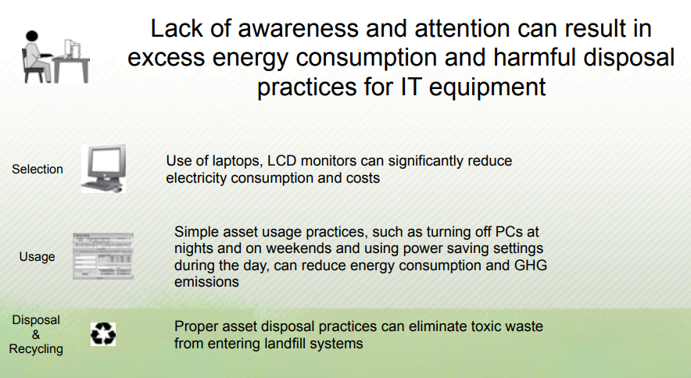
Real Reported Issues

Slide 19
Green IT - Associated Benefits
Reduced carbon and other GHG emissions
Increased cooling efficiency in the data center
Reduced energy costs
Cost savings
Improved financial performance
Positive publicity

Slide 20
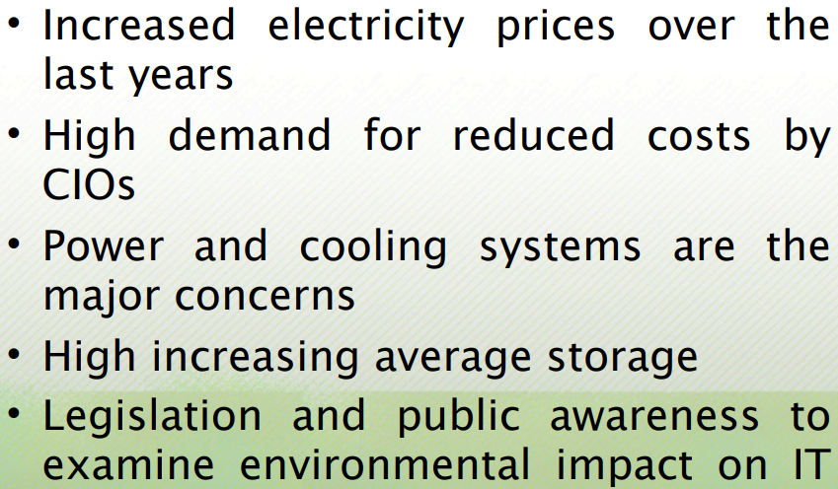
Drivers

Slide 21
10 Tips to implement Green IT Practices

Slide 22
#1: Buy energy efficient hardware
New offerings from major hardware vendors include notebooks, workstations, and servers that meet the EPA's Energy Star guidelines for lower power consumption. Look for systems that have good EPEAT ratings (www.epeat.net). The ratings use standards set by the IEEE to measure "environmental performance." All EPEAT-registered products must meet Energy Star 4.0 criteria.
Multicore processors increase processing output without substantially increasing energy usage. Also look for high efficiency (80%) power supplies, variable speed temperature controlled fans, small form factor hard drives, and low voltage processors.

Slide 23
#2: Use power management technology and best practices
Modern operating systems running on Advanced Configuration and Power Interface (ACPI)-enabled systems incorporate power-saving features that allow you to configure monitors and hard disks to power down after a specified period of inactivity. Systems can be set to hibernate when not in use, thus powering down the CPU and RAM as well.
Hardware vendors have their own power management software, which they load on their systems or offer as options. For example, HP's Power Manager provides real-time reporting that shows how the settings you have configured affect the energy used by the computer.

Slide 24
There are also many third-party power management products that can provide further flexibility and control over computers' energy consumption. Some programs make it possible to manually reduce the power voltage to the CPU. Others can handle it automatically on systems with Intel SpeedStep or AMD Cool'n'Quiet technologies.
Other technologies, such as Intel's vPro, allow you to turn computers on and off remotely, thus saving energy because you don't have to leave systems on if you want, for example, to schedule a patch deployment at 2:00 A.M.

Slide 25
#3: Use virtualization technology to consolidate servers
You can reduce the number of physical servers, and thus the energy consumption, by using virtualization technology to run multiple virtual machines on a single physical server. Because many servers are severely underutilized (in many cases, in use only 10 to 15 percent of the time they're running), the savings can be dramatic. VMWare claims that its virtualized infrastructure can decrease energy costs by as much as 80 percent.
The same type of benefits can be realized with Microsoft's Hyper-V virtualization technology, which is an integrated operating system feature of Windows Server 2008

Slide 26
#4: Consolidate storage with SAN/NAS solutions
Just as server consolidation saves energy, so does consolidation of storage using storage area networks and network attached storage solutions. The Storage Networking Industry Association(SNIA) proposes such practices as powering down selected drives, using slower drives where possible, and not overbuilding power/cooling equipment based on peak power requirements shown in label ratings.

Slide 27
#5: Optimize data center design
Data centers are huge consumers of energy, and cooling all the equipment is a big issue. Data center design that incorporates hot aisle and cold aisle layout, coupled cooling (placing cooling systems closer to heat sources), and liquid cooling can tremendously reduce the energy needed to run the data center.
Another way to "green" the data center is to use low-powered blade servers and more energy-efficient uninterruptible power supplies, which can use 70 percent less power than a legacy UPS.
Optimum data center design for saving energy should also take into account the big picture, by considering the use of alternative energy technologies (photovoltaics, evaporative cooling, etc.) and catalytic converters on backup generators, and from the ground up, by minimizing the footprints of the buildings themselves. Energy-monitoring systems provide the information you need to measure efficiency. This Microsoft TechNet article discusses various ways to build a green data center.

Slide 28
#6: Use thin clients to reduce GPU power usage
Another way to reduce the amount of energy consumed by computers is to deploy thin clients. Because most of the processing is done on the server, the thin clients use very little energy. In fact, a typical thin client uses less power while up and running applications than an Energy Star compliant PC uses in sleep mode. Thin clients are also ecologically friendly because they generate less e-waste. There's no hard drive, less memory, and fewer components to be dealt with at the end of their lifecycles.
Last year, a Verizon spokesman said the company had decreased energy consumption by 30 percent by replacing PCs with thin clients, saving about $1 million per year.

Slide 29
#7: Use more efficient displays
If you have old CRT monitors still in use, replacing them with LCD displays can save up to 70 percent in energy costs. However, not all LCD monitors are created equal when it comes to power consumption. High efficiency LCDs are available from several vendors.
LG recently released what it claims is the world's most energy efficient LCD monitor, the Flatron W2252TE. Tests have shown that it uses less than half the power of conventional 22-inch monitors.

Slide 30
#8: Recycle systems and supplies
To reduce the load on already overtaxed landfills and to avoid sending hazardous materials to those landfills (where they can leach into the environment and cause harm), old systems and supplies can be reused, repurposed, and/or recycled. You can start by repurposing items within the company; for example, in many cases, when a graphics designer or engineer needs a new high end workstation to run resource-hungry programs, the old computer is perfectly adequate for use by someone doing word processing, spreadsheets, or other less intensive tasks. This hand-me-down method allows two workers to get better systems than they had, while requiring the purchase of only one new machine (thus saving money and avoiding unnecessary e-waste).
Old electronics devices can also be reused by those outside the company. You can donate old computers and other devices still in working order to schools and nonprofit organizations, which can still get a lot of use out of them. Finally, much electronic waste can be recycled, the parts used to make new items. Things like old printer cartridges, old cell phones, and paper can all be recycled. Some computer vendors, such as Dell, have programs to take back computers and peripherals for recycling.

Slide 31
#9: Reduce paper consumption
Another way to save money while reducing your company's impact on the environment is to reduce your consumption of paper. You can do this by switching from a paper-based to an electronic workflow: creating, editing, viewing, and delivering documents in digital rather than printed form. Send documents as e-mail attachments rather than faxing.
And when printing is unavoidable, you can still reduce waste and save money by setting your printers to use duplex (double-sided) printing. An internal study conducted by HP showed that a Fortune 500 company can save 800 tons of paper per year (a savings of over $7 million) by printing on both sides.

Slide 32
#10: Encourage telecommuting
The ultimate way to have a greener office to have less office. By encouraging as many workers as possible to telecommute, you can reduce the amount of office space that needs to be heated and cooled, the number of computers required on site, and the number of miles driven by employees to get to and from work. Telecommuting reduces costs for both employers and employees and can also reduce the spread of contagious diseases.

